Slide 1
Practical session with ABB robots
ASE-9407 Robot Manipulators: Modeling, Control and Programming

Slide 2
Outline
FASTory introduction
Core concepts
Assignment 2 kickoff
Tips
Targets teaching

Slide 3
Core concepts
Main Components
Joints and links
Degree of Freedom (DOF)
Orientation
Tool, Tool Central Point (TCP)
Coordinate system
Cartesian and joint movement
Inverse kinematics, Reachability, Singularities
Robot configurations

Slide 4
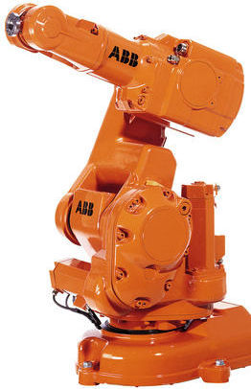
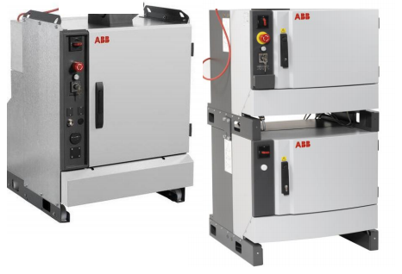
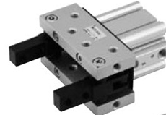
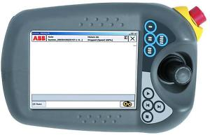
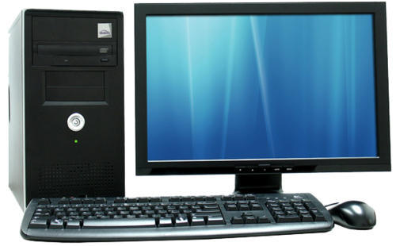
Main Components
Manipulator
Drives
Tool
Controller
PC-RS
Teach pendant

Slide 5
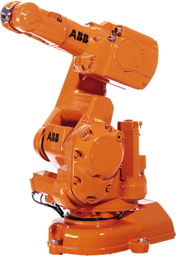
IRB 140
Multipurpose
6 kg payload
Reachability 810 mm
Axis 1 rotation 360 degrees
Main applications
Arc welding
Assembly
Cleaning/Spraying
Machine tending
Material handling
Packing
Deburring

Slide 6
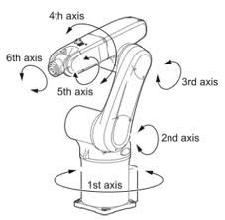
Joints and links

Slide 7
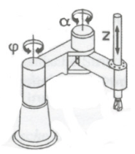
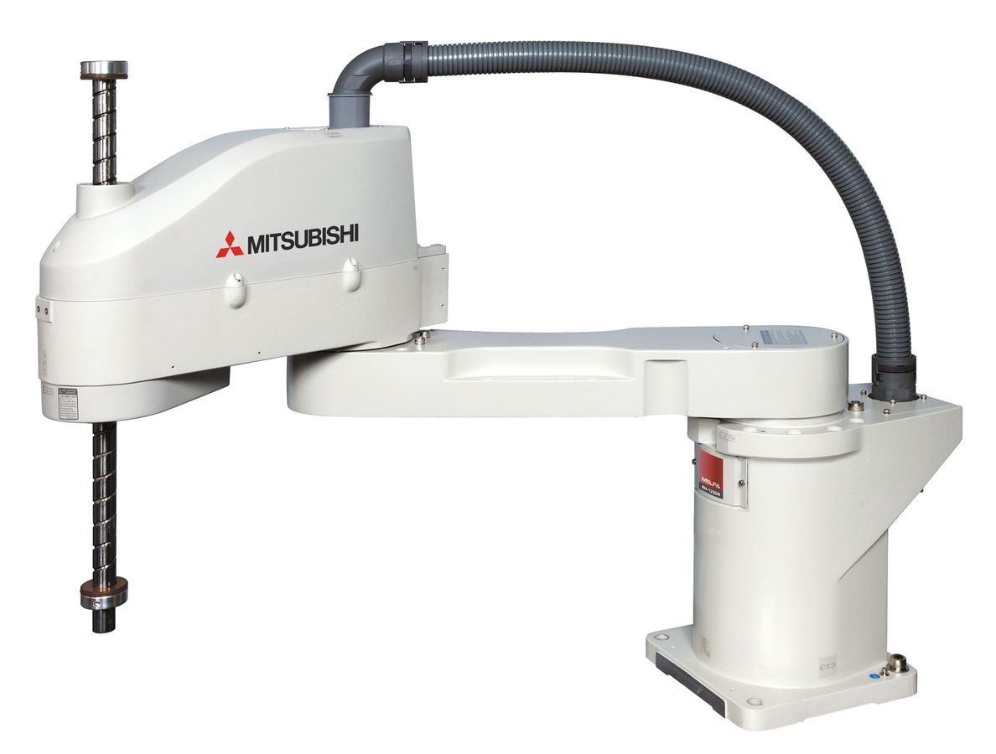
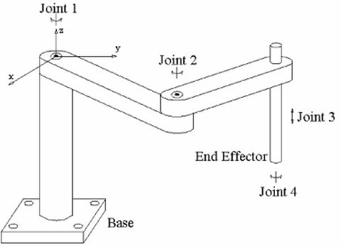
Degrees of Freedom (DoF)
Position and orientation
3 DoF
[x,y,z]
4 DoF
[x,y,z,θ]

Slide 8
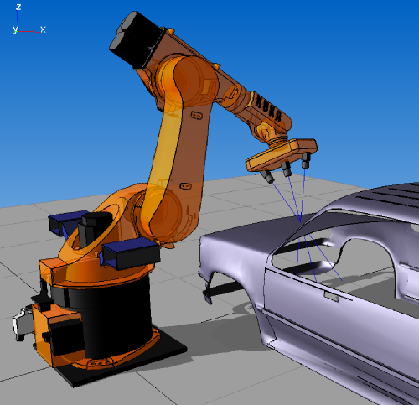
Degrees of Freedom (DoF)
6 DoF
DoF related with the number of joints (degree of mobility)

Slide 9
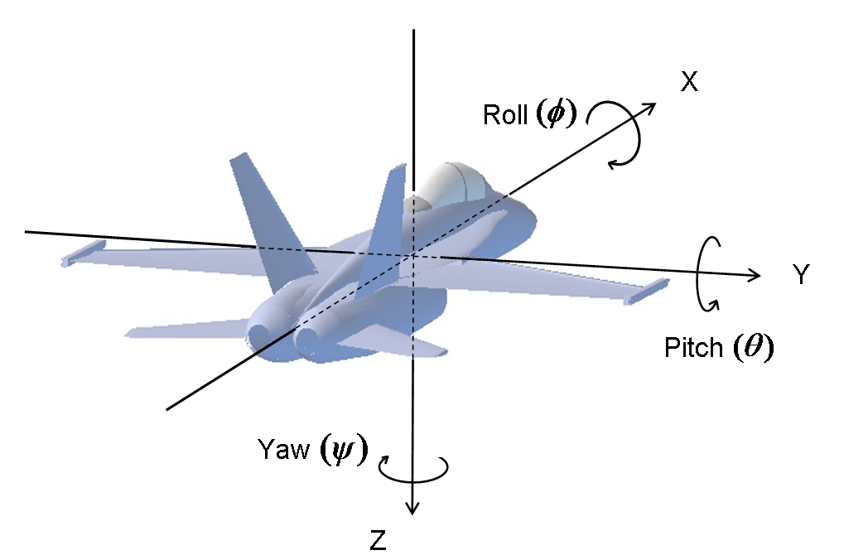
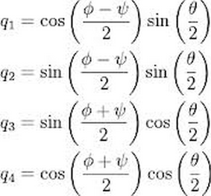
Orientation
Euler angles
Quaternions
Gimbal Lock

Slide 10
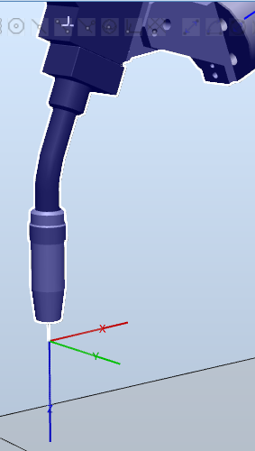
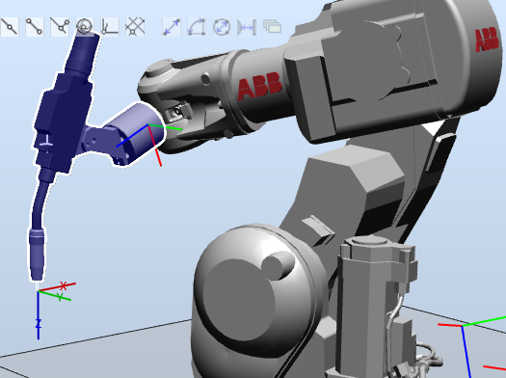
Tool Central Point (TCP)

Slide 11
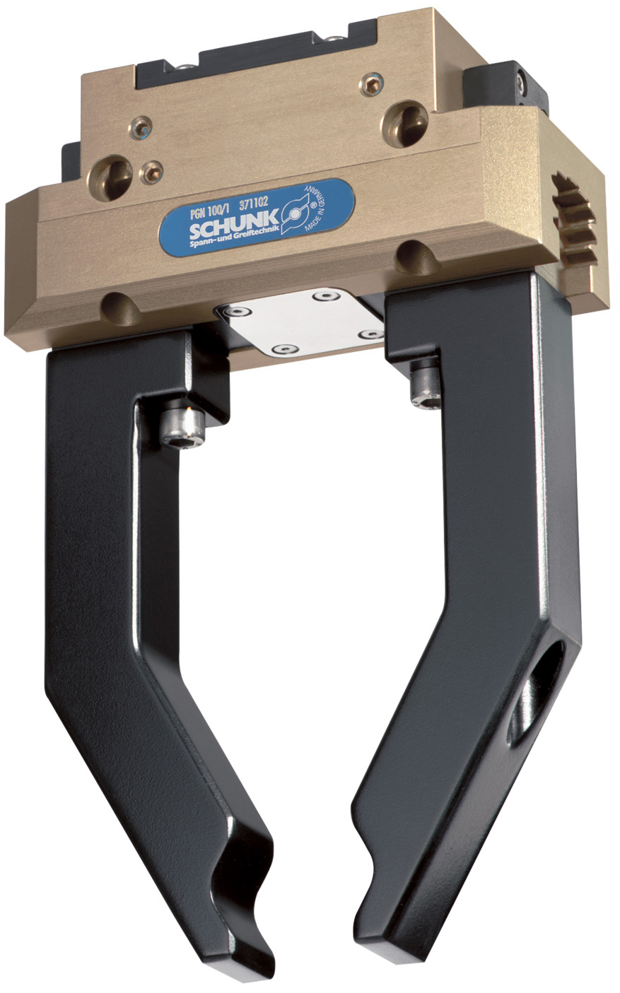
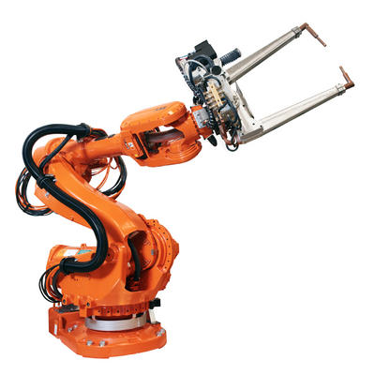
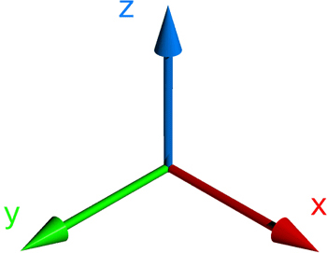
Tool Central Point (TCP)

Slide 12
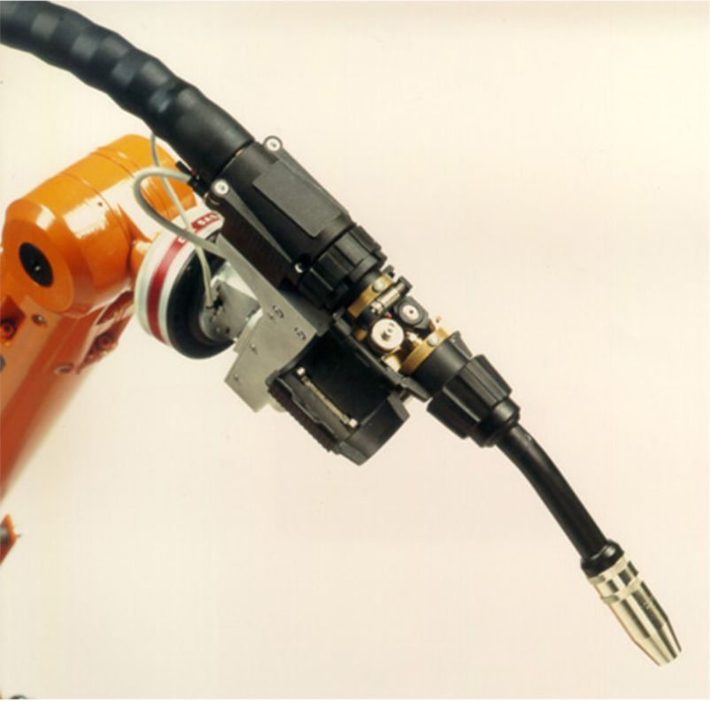
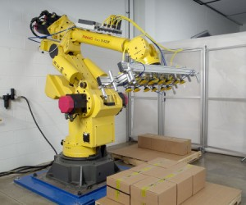
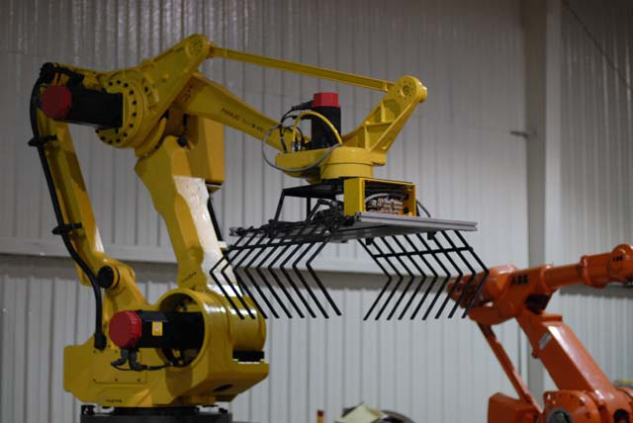
Tool Central Point (TCP)

Slide 13
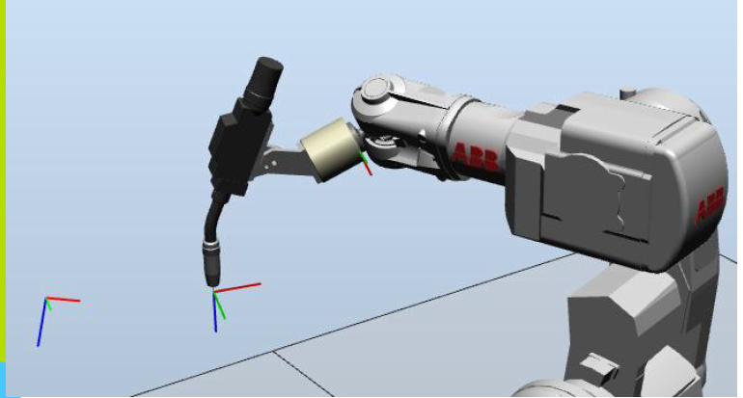
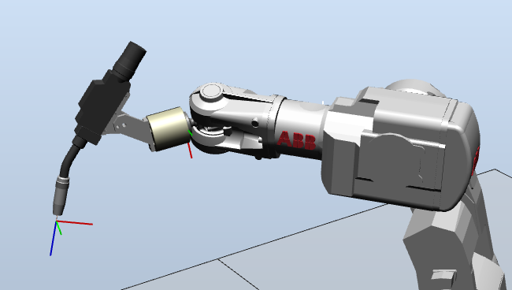
Tool Central Point (TCP)

Slide 14
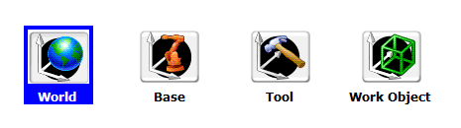
Coordinate system (reference frame)
{C2}
{C1}
target

Slide 15
Other concepts
Linear (Cartesian) and joint movement
Inverse kinematics:
compute the joints to achieve position+orientation
Reachability
Singularities

Slide 16
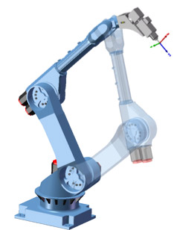
Robot configuration

Slide 17
Robot Studio
RobotWare
System layout
Offline programming
Emulate physical components:
Teach pendant
Robot controllers
RAPID editor

Slide 18
Robot Studio: tool
Rapid: programming language
RobotWare: Firmware inside the robot controller
RobotWare: 5.15.14

Slide 19
Robot Studio: Pick and place flow
Design 3D system
Define work objects / targets
Synchronize controller
Create flow control on RAPID code
Set/fix orientations
Offline testing
Deploy
Fix targets positions by teaching/updating targets

Slide 20
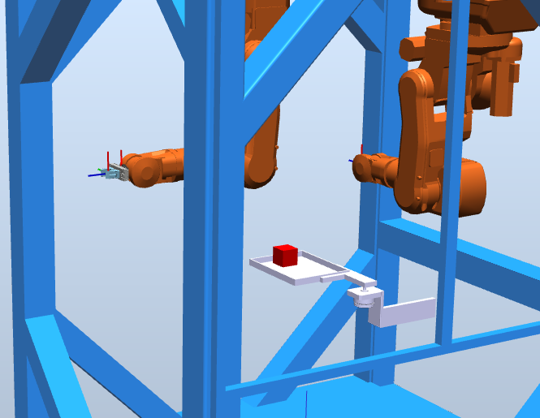

Slide 21
Robot Studio: Path creation flow
Design 3D system
Define work objects / targets
Create path
Synchronize controller
Set/fix orientations
Modify/create RAPID code
Test
Deploy

Slide 22
Assignment 2 Kickoff

Slide 23
Teaching targets with the teach pendant

Slide 24
Robot studio
RSPAG files
Network license
Robotware 5.15.14 for Task 2

